Slide 1
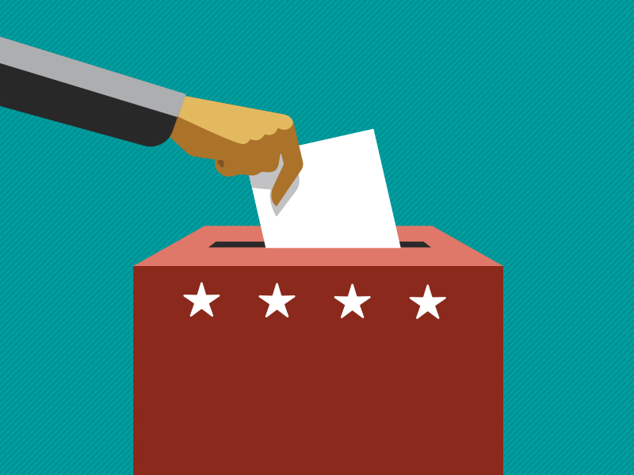

2018 Education Plan

Slide 2
2018 Voter Education | Connections
Campaign Goals
Motivate Arizona voters to vote informed in state and local elections
Strategic Approach
Demonstrate the tangible and emotional benefits of voting informed
Notes:
Reinforce that CCEC provides the necessary tools and resources and information for voters to participate. Important for voters to understand that the information that comes out of CCEC is non-partisan unbiased and factual
Look back to the reseach

Slide 3
2018 Voter Education | Connections
Recommended Media Mix
TV
Radio
Print
Digital and Online Video (YouTube)
Social (Facebook, Twitter and Instagram)
Paid Search

Slide 4
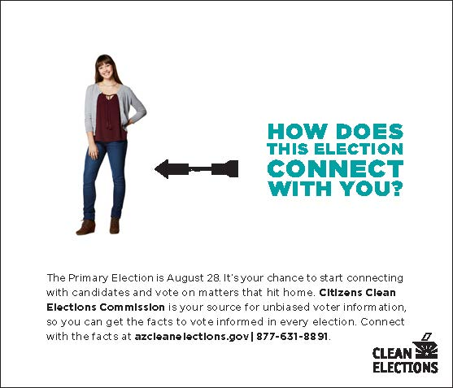
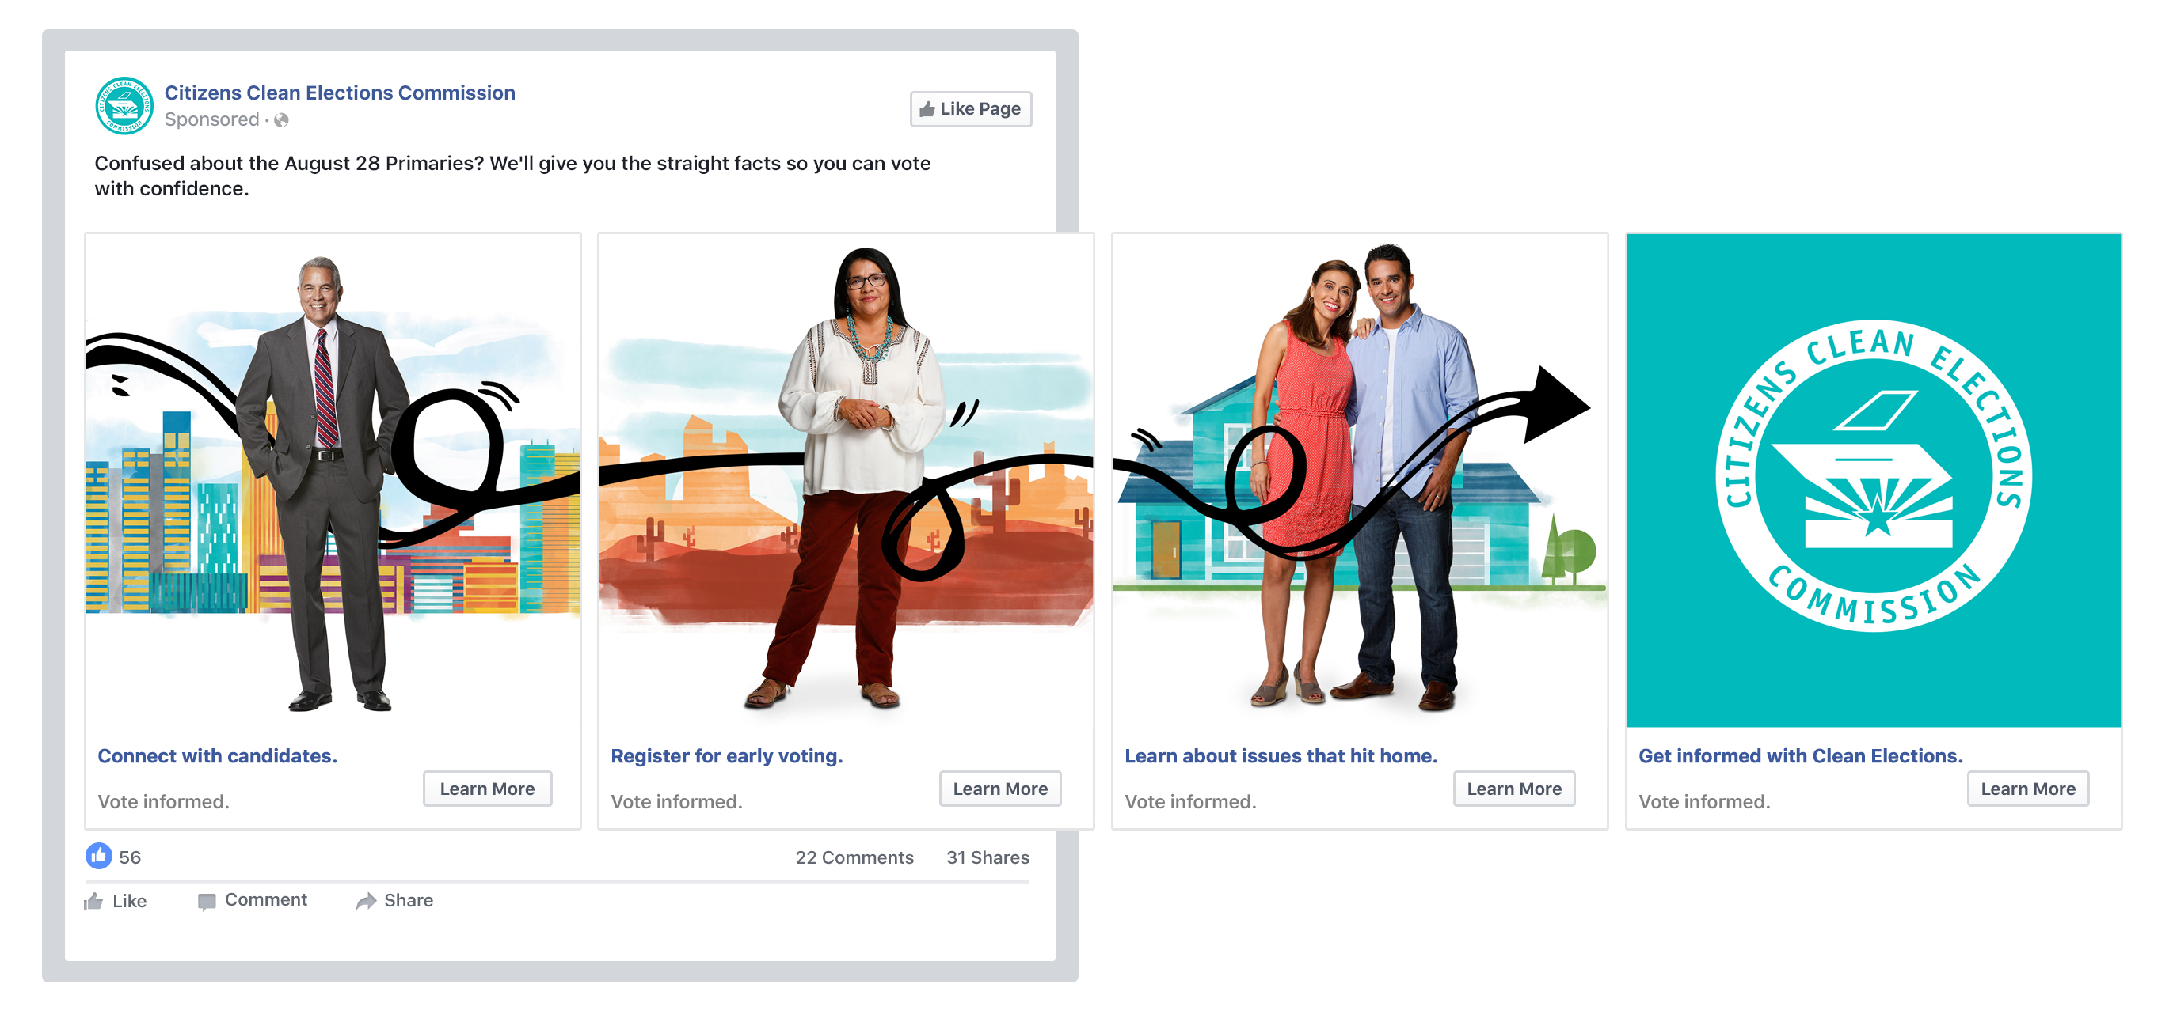
2018 Voter Education | Connections

Slide 5

2018 Voter Education | 18in2018
Campaign Goals
Increase voter registration among young adult audiences
Educate target audience(s) about tools & resources provided by CCEC
Strategic Approach
Challenge young adults to take advantage of their new power- the power to vote, by shining light on the impact that youth have/have had in democracy

Slide 6
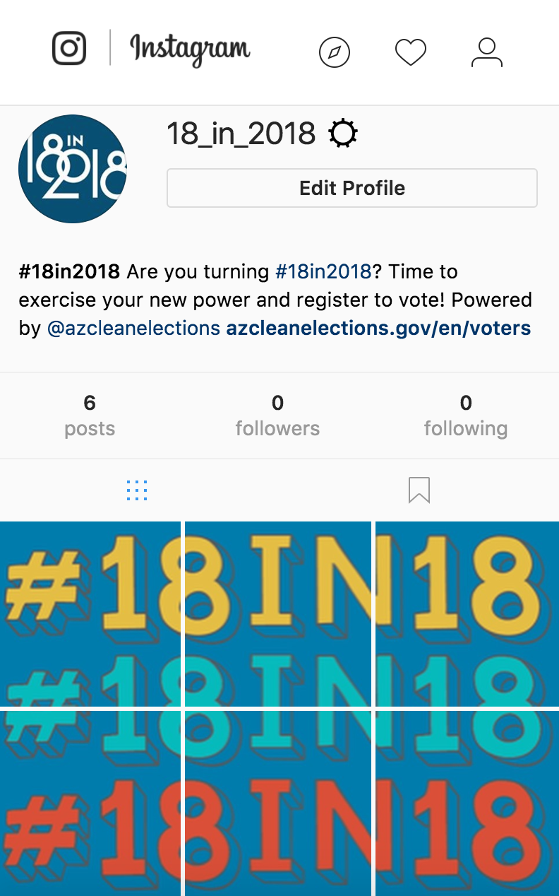

2018 Voter Education | 18in2018

Slide 7
Debates
Governor
Secretary of State
Attorney General
State Treasurer
Superintendent of Public Instruction
State Mine Inspector
Corporation Commissioner (elect 2)
Legislative

Slide 8

Guide
Re-design for a more visually appealing experience
Including more voter information including ID at the Polls, Ways to register, How to vote, etc.
Integrating the 2018 Education Campaign look and feel
Continuing a district specific approach for cost savings
Notes:
Working with the Center for Civic Design to provide a better user experience to aid in the overall understanding of the guide (reference research)

Slide 9
Independent Voters
Campaign Goals
Increase awareness of the actions independent voters need to take in order to vote in the Primary Election in August
Strategic Approach
Inform and educate Arizona voters that Arizona has an open primary, which means all registered voters can participate in the August Primary Elections

Slide 10
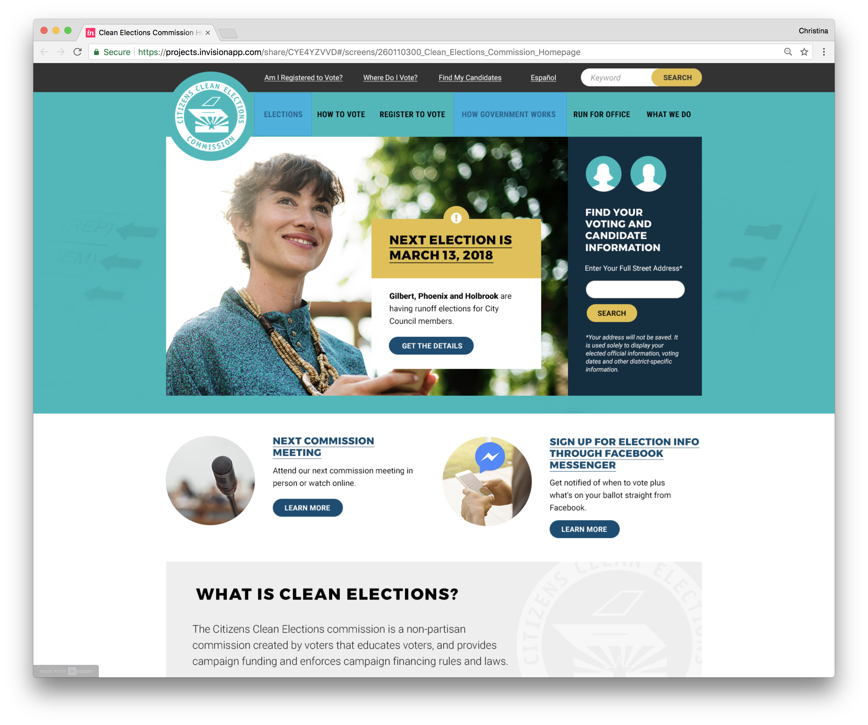
Website

Slide 11

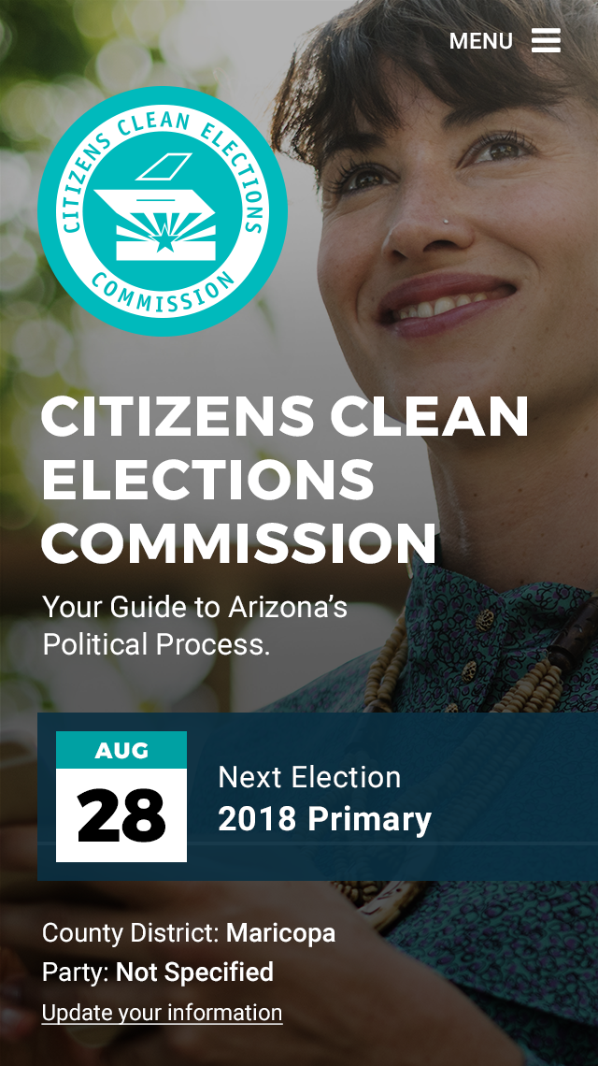
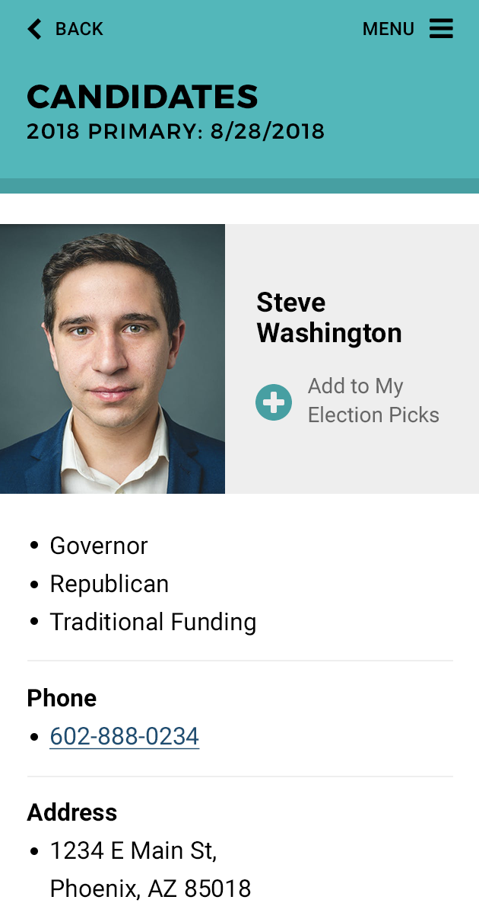
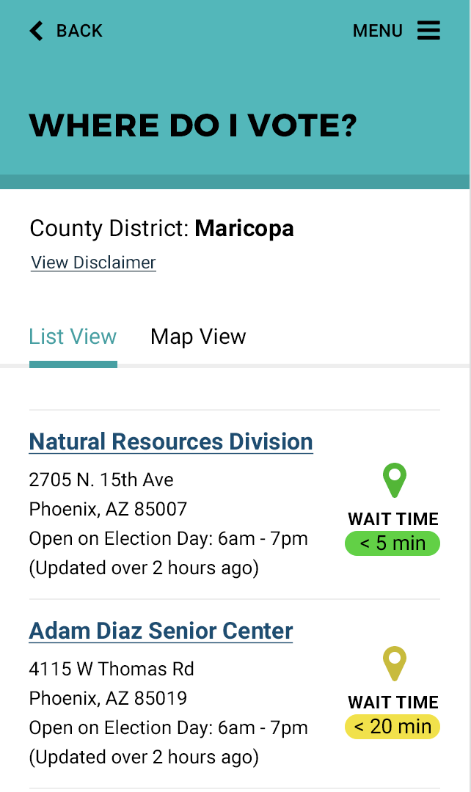
2018 Voter Education | Mobile App

Slide 12
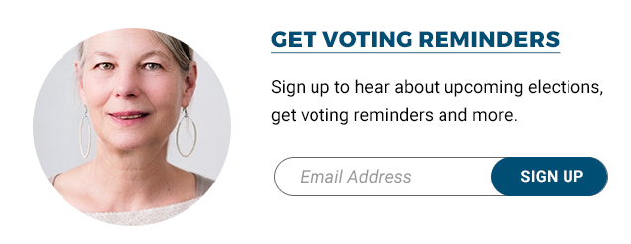
Email
Option for voters to sign up for notifications on our new website
Designed to send a series of e-mails with election information, voting reminders, etc.

Slide 13
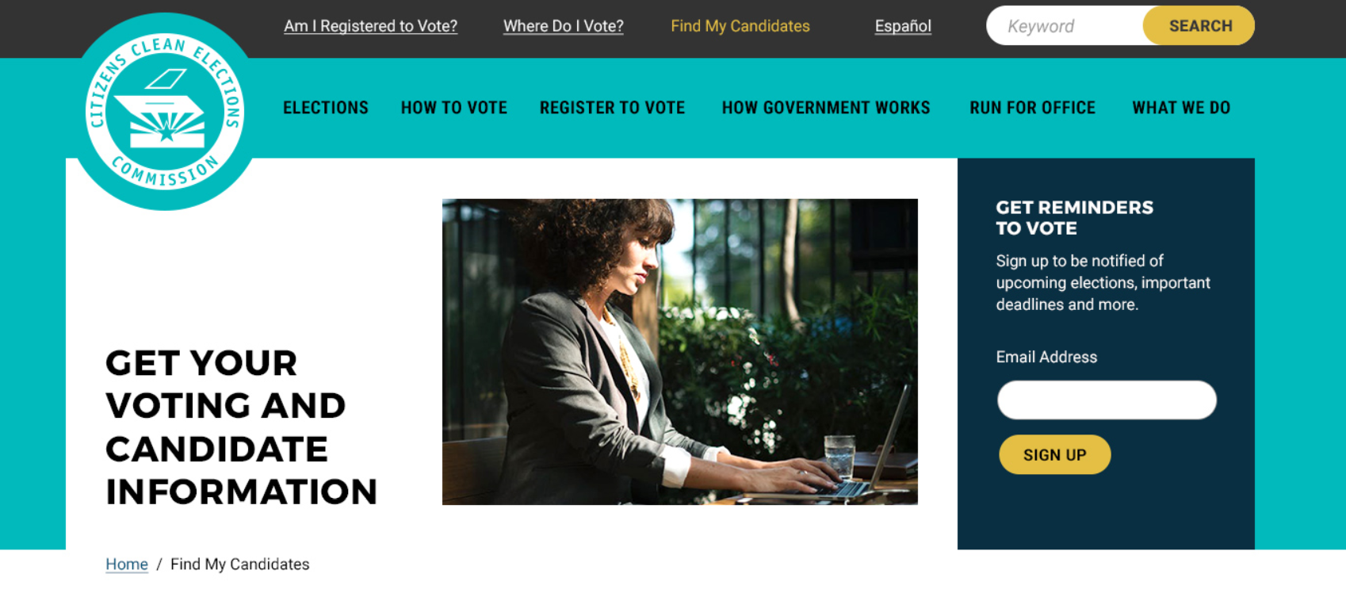
Voter Dashboard

Slide 14
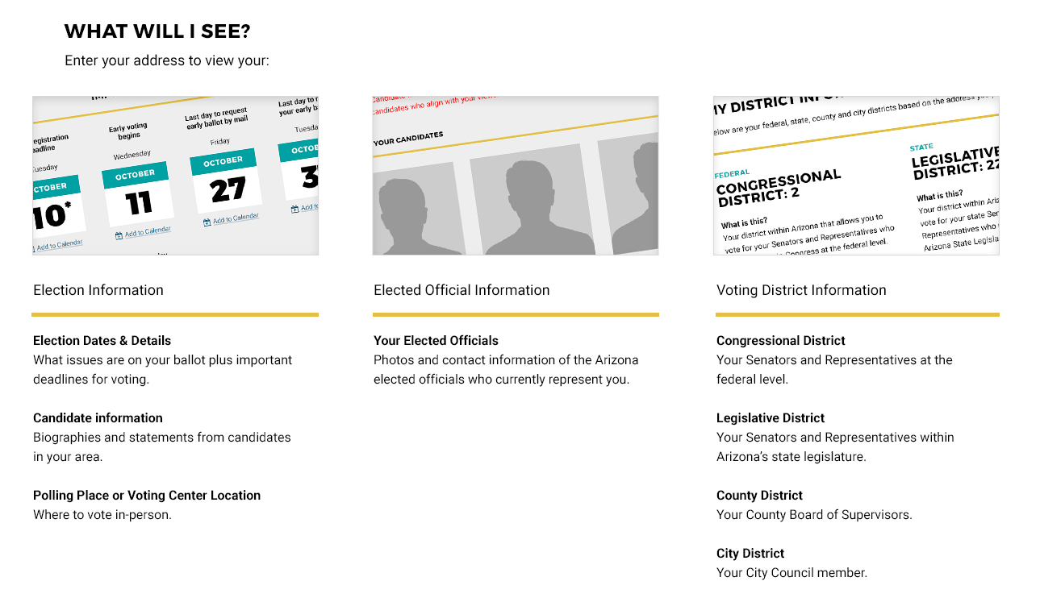
Voter Dashboard

Slide 15
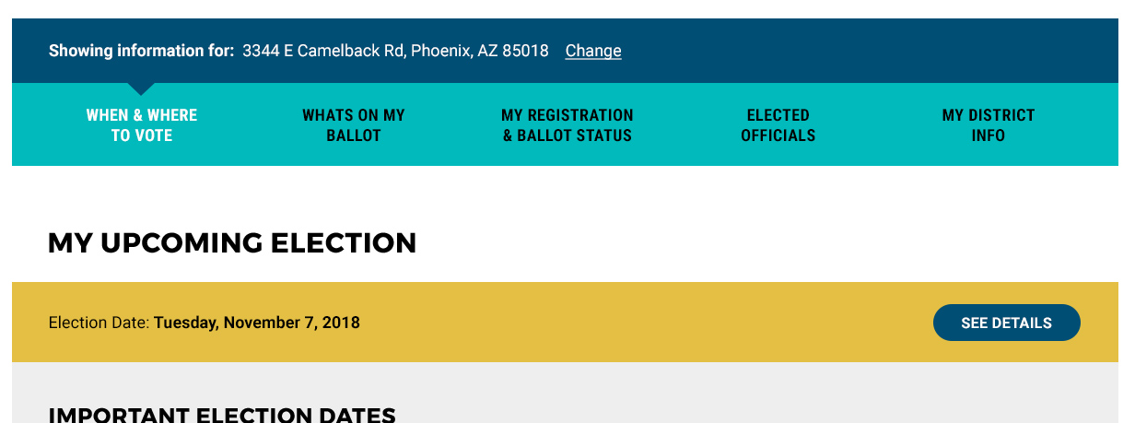
Voter Dashboard

Slide 16
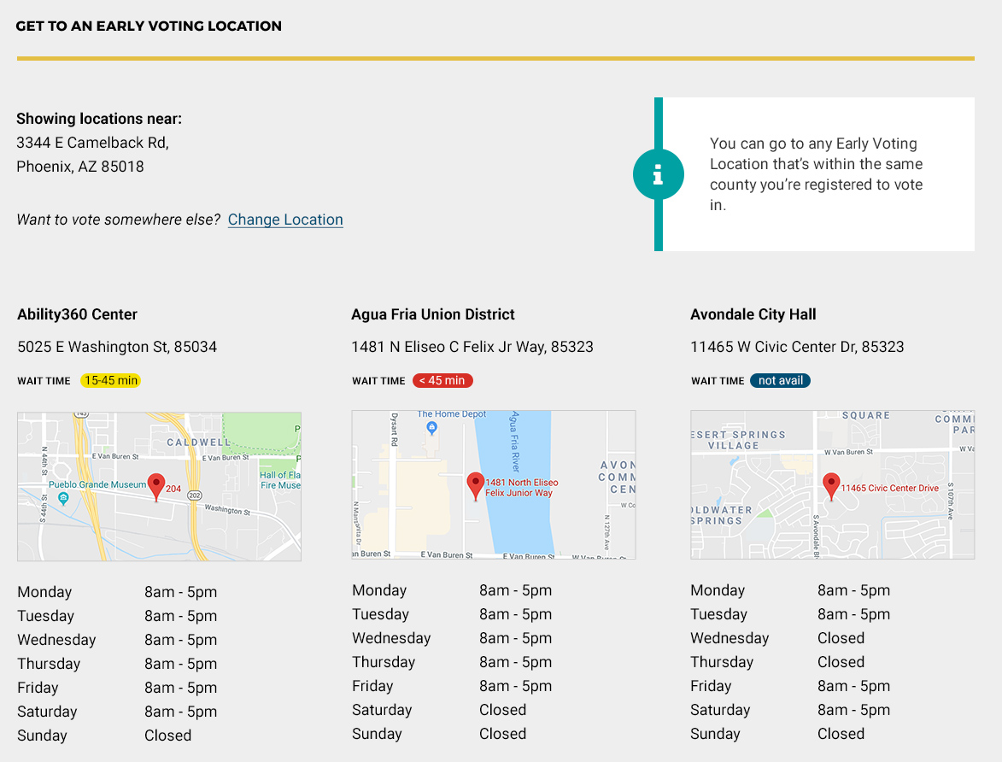
Voter Dashboard

Slide 17


Partnership with Maricopa County
&

Slide 18
Partnership with Maricopa County
Information Sharing
Voter Registration
Ballot Status
Voting Locations
Districts
Notes:
Information where maricopa has publicly displayed, we’ll have access to it through an API (departments working together) going to show the dashboard, which we’ve been working on for the past year. Integrated this data into the dashboard, for maricopa residents. Voters can verify their registration status, verify their ballot status (checking early or provisional), find their assigned voting location, and even look up their district all through the dashboard. Provides a one stop shop for all of this voter information. Now that we have access to city council information, candidates at the local level can now create a profile on our website. Voters in Maricopa can see what city district they reside in and any profiles that local caniddates have created that are applicable. Main goal for this presentation, we want the clerks to look what we’re doing and realize that we are a good asset for them.
In June, CCEC met with Maricopa County voter outreach team, this enables us to speak with voters while being as informed as possible. That we are all on the same page.
ERIC Mailing, state has since joined a program called ERIC (this replaced the cross state matching system). Electronic Registration Information Center A requirement of ERIC is that the counties must send a EBU mailing (eligible but unregsitered). Clean Elections worked with a subcommittee with the counties on the design of the mailer. We have been communicating with Maricopa county to let voters know this mailer is coming. Communicating about what efforts we can do to educate residents that this mailer is coming and the intent of it. Intent is to get them registered and to let them know about the mailer. County wants us to do some promotion, advertisement to get the word out that this mailer is coming. If you are able to register to do so.

Slide 19
Partnership with Maricopa County
Collaboration
Worked with Peoria City Clerk for Compass
Met with Maricopa County Voter Outreach
ERIC Mailing

Slide 20
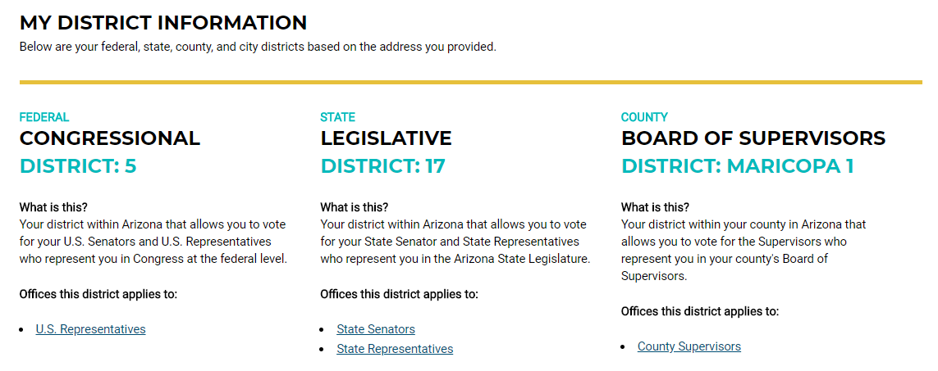
Notes:
Example of District Information Tab in Dashboard. Coming Soon callout for local

Slide 21
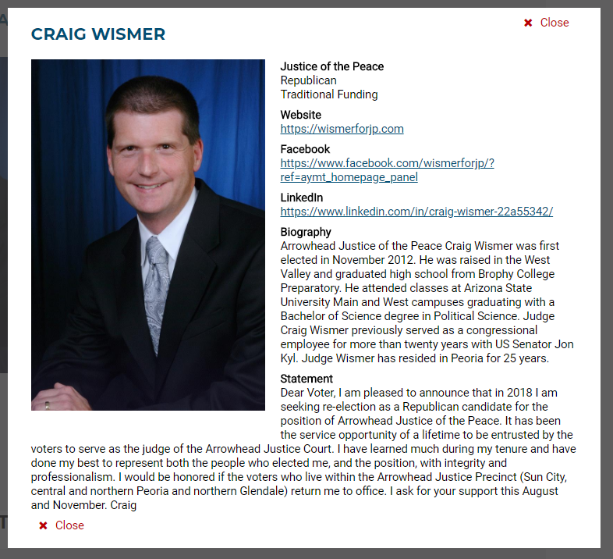
Notes:
Profile example

Slide 22
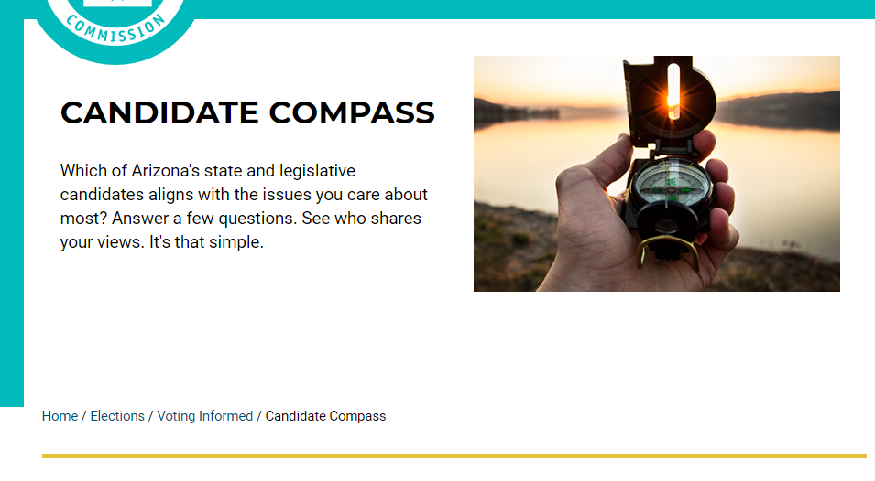
Notes:
CCEC worked with Peoria to get compass questions for city council candidates. These questions are applicable to the role of city council members. We will email any local candiate in our system letting them know to use compass. We will contact maricopa and look at list of candidates that have filed, any candidates that don’t have a login with us we will reach out to. AMCA president has been asked to let candidates know of this portal. For local aspect mention working with peroia on development of municipal questions.

Slide 23

THANK YOU

